Slide 1
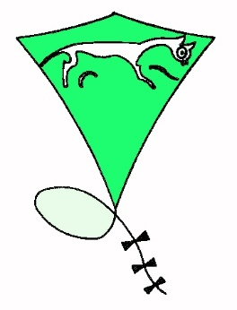
A kite time line.
Prepared by
Arthur Dibble
Vice-president WHKF
arthur.dibble@ntlworld.com
www.tedberets.co.uk

Slide 2
Circa 1000BC
A nice little story is that the first kite was from a Chinaman who was out fishing and the wind blew his coolie hat off. As he cast his line out the hook caught on the brim and it sailed in to the air. A good story but not proven.

Slide 3
196BC
General Han Hsin’s army besieged a city, but were unable to get in so the General devised a plan to dig a tunnel under the walls and surprise the enemy from inside. How ever he didn’t know how far to dig. By flying a kite above the walls, measuring the angle and length of string he was able to calculate it.
As we all know from our trigonometry lessons:-
A=H.cosθ

Slide 4
600AD
General Gim Yu-Sin’s army was in battle when a shooting star fell to earth. This was considered to be a very bad omen and his men became scared. One night he fixed a fire ball below a kite and flew it in to the air. When his troops saw this they thought it was the star ascending and their confidence was restored and they won the battle.

Slide 5
1295AD
Marco Polo introduces kites to Europe.

Slide 6
No one knows how long Islanders from the Southern Pacific Island have been using leaf kites for fishing.
A second line is attached to the kite with a hook on the end disguised using raw cotton. The kite is then flown out over the water at a height to trail the lure across the surface. This stops the shadow of the fisherman for frightening the fish.

Slide 7
Circa 1600AD
Kites were used to rescue the crews of ships wrecked on the rocks. If the wind was in the right direction they would fly a kite over the cliffs and this could be caught by people on land. They would use the kite line to pull heavier ropes up until they were strong enough for the crew to climb up.

Slide 8
1752AD
Benjamin Franklyn flew a kite up in to a thunderstorm to prove that lightening was similar to the electricity that they had started to produce on the ground.
Don’t try this yourselves or you may end up as toast like a number of others who followed Franklyn.

Slide 9
1822AD
George Pocock harnessed a large kite to the front of a carriage, in place of horses, and completed journeys of up to 100 miles some times at speeds of over 20 mph.
This made life difficult for the toll keepers who’s charges depended on the number of horses that were pulling you carriage.

Slide 10
1844AD
When they wanted to build a bridge across the Niagara river below the falls the biggest problem was to get the first line across. They therefore held a competition to see who could be first to fly a kite from one side to the other.
This was eventually won by a 12 year old boy.

Slide 11
1893AD
During the Boer war Captain Baden-Powell used a train of large kites to lift a man to get a better view of where their canon shells were landing and thus instruct the gunners how to become more accurate.

Slide 12
1901AD
Marconi used a kite to lift the aerial for the first ever radio link from Europe to America.

Slide 13
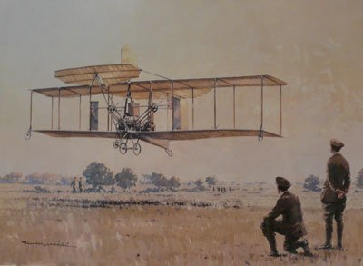
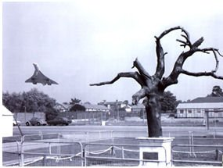
1908AD
Possibly the most significant contribution from kites was their use in development of the aeroplane. In Britain this was done by an American adventurer and circus performer Samuel Cody who named himself after Buffalo Bill.
He worked on man-lifting kites and also the power of engines by tethering them to a tree and seeing how hard they could pull. He then added an engine and propeller to the front of a kite and made the first powered flight in the UK in 1908.
An aluminium replica of the tree now stands on Farnborough airfield and a model of his first ‘plane in the near-by museum.

Slide 14
Cody also designed a boat that could be towed by a kite and he successfully used it to make a crossing of the channel.

Slide 15
1943AD
During the second world war Captain Paul Garber designed a kite that could be steered and with a picture of a plane on it this could be used as a moving target for training RAF fighter pilots and gunnery crews.

Slide 16
Another use of kites during the war was for lifting the antenna of a hand cranked radio when an airman ditched at sea. This was named the Gibson Girl due to the shape of the transmitter that reminded one of the shape of the girls in the dance troop of the same name.

Slide 17
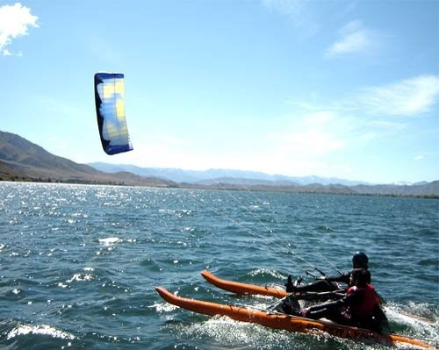
Traction today
Pocock’s Charvolant became the basis of modern day buggies and Cody’s boat for a catamaran. Both were developed by Peter Lynn a famous New Zeeland kite maker.

Slide 18
More recently commercial uses of kites are being developed with a company called Sky Sails using a huge kite to assist tankers at sea. This has already lead to savings of 30% in fuel used in an Atlantic crossing.

Slide 19
2017AD
The most exciting current concept is the possibility of using kites to capture the power of the wind at high levels to generate electricity.
Several systems are being tried and the first one has been allocated funds for a pilot version to be built in Scotland.

Slide 20
WARNINGS
Always fly safely
Always be considerate to other people using the same area whether it is noise or physical intrusion into their space.
Never fly at a height of more than 60 metres above ground level unless a CAA clearance is in force (as at kite festivals). If you don’t know what the clearance is ASK!
Never fly a kite in wet or stormy weather. Always try and keep your line dry.
Never fly a kite near power lines, transmission towers or aerials.
Never fly near Motorways, roads, car parks or railways.
Never fly near airfields. The maximum height limit in any area of restricted air space is 30 metres.
Never have any metal in the flying line and do not attach anything sharp to the line.
Always make sure that you use an adequate anchor for large kites and never leave them unattended.
Always wear strong gloves when flying large kites.
Always give priority to domestic animals particularly if they are showing signs of distress.
Always clear up after yourself, especially lines, tails and bits of plastic that could trap, choke or injure domestic animals.
Never fly near those kite-eating trees.
Finally remember…..your kites can get really quite lonely up high in the sky; just occasionally, look up and give them a SMILE. It will make you feel better too.

Slide 21
If you want to see more
Please come to
our monthly fly-in,
Second Sunday every month
at
Barbury Castle near Swindon
www.whkf.org.uk

Slide 22
That’s all folks thank you for you attention

